Slide 1
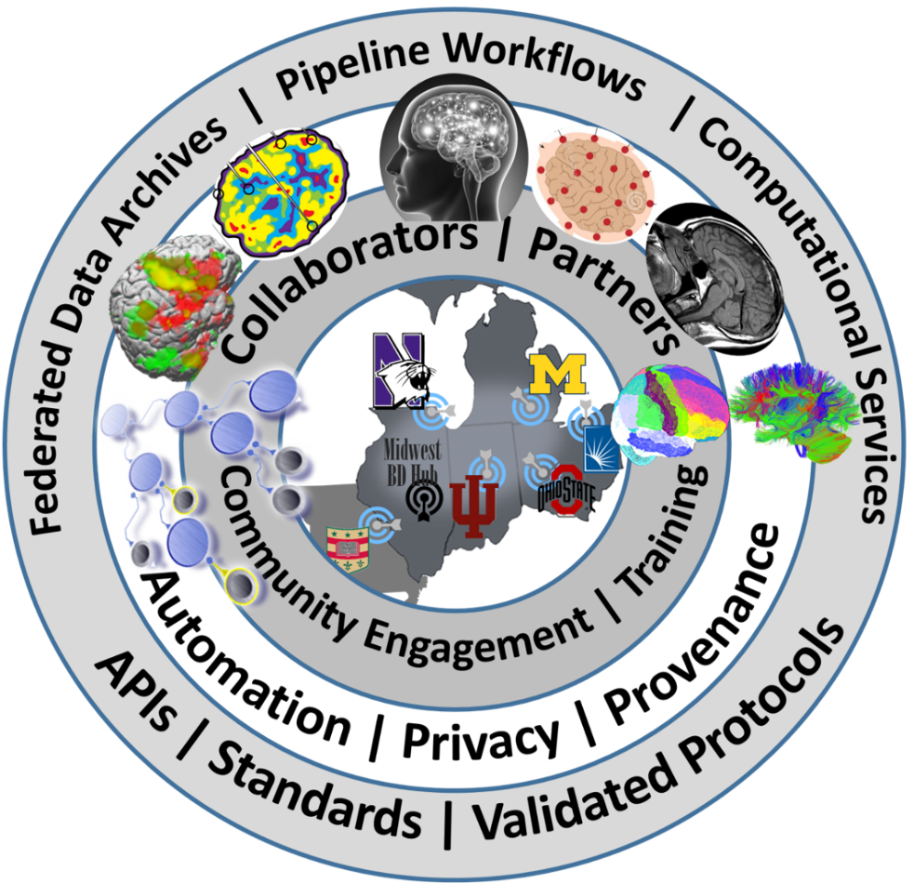

Midwest Workshop on Big Neuroscience Data, Tools, Protocols & Services
Computational Neuroscience Network (ACNN)
http://www.NeuroscienceNetwork.org/ACNN_Workshop_2016.html

Slide 2


Michigan Institute for Data Science
Ivo D Dinov
Statistics Online Computational Resource (SOCR)
Michigan Institute for Data Science (MIDAS)
University of Michigan
http://www.umich.edu/~dinov

Slide 3

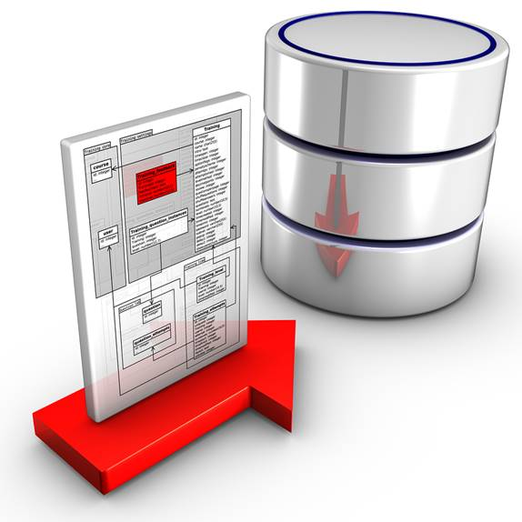
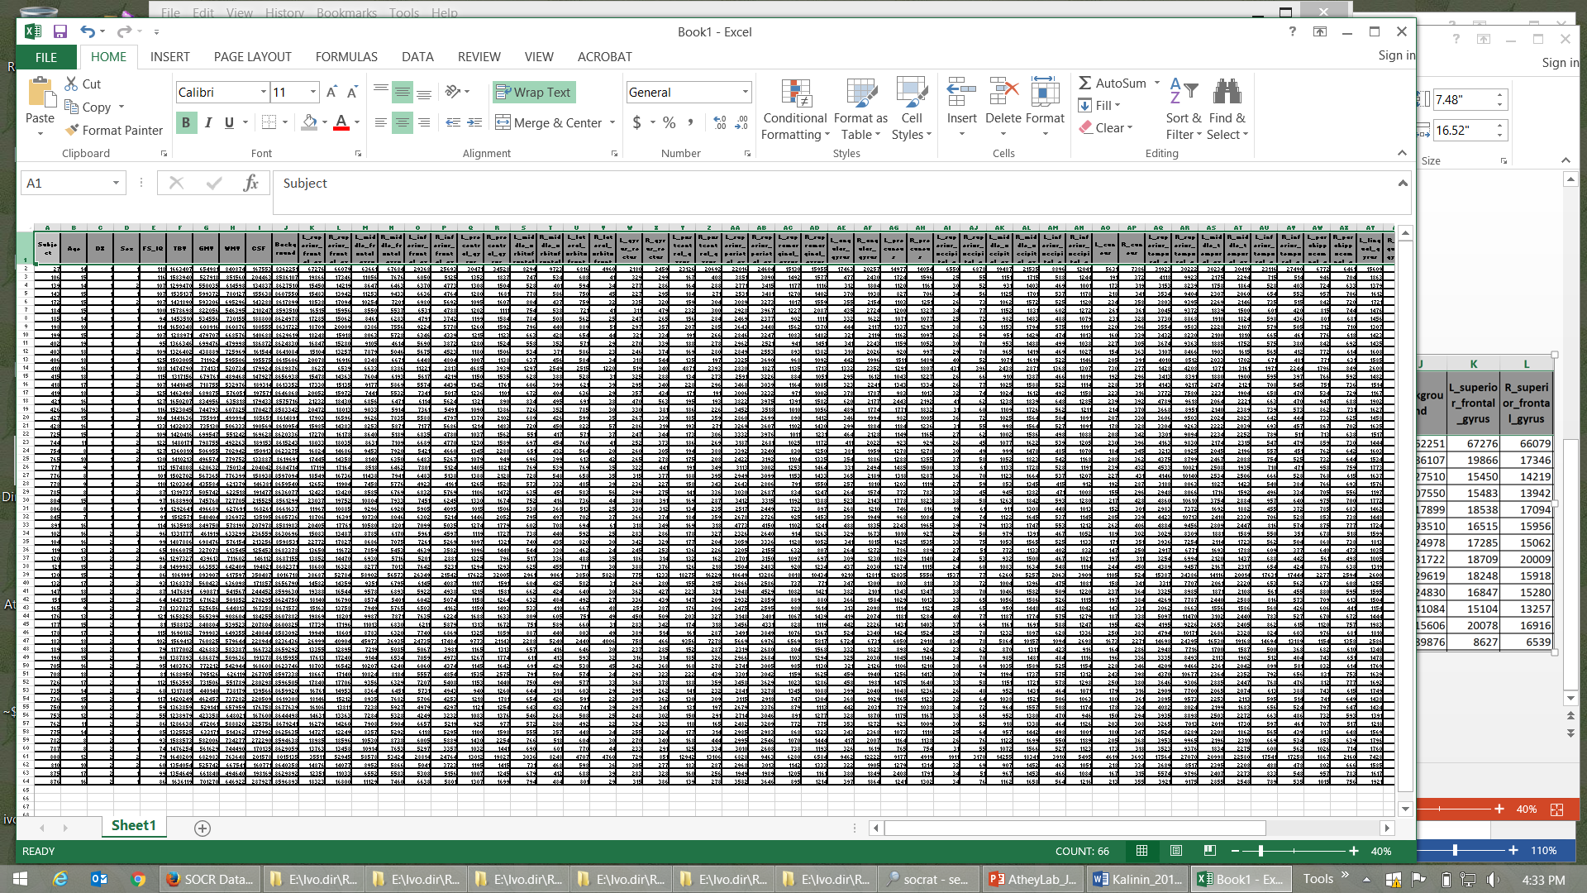

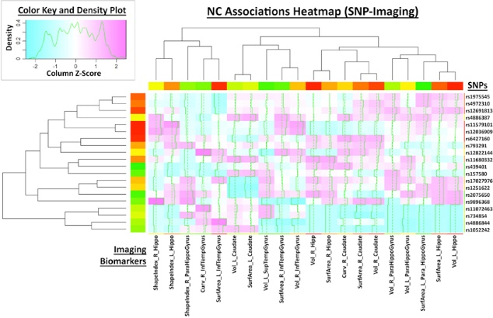
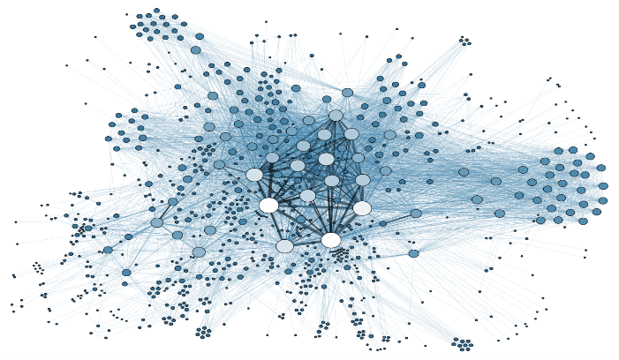
Big Neuroscience Data
TBD
Data
Wrangling
Data
Modeling
Data
Analytics
Data
Visualization

Slide 4
Big Neuroscience Data
Case-Studies | Sample-size | Data Elements | Description
ALS | Longitudinal data for 8K patients (data comes from 2 independent EU registries) | >300 variables including incomplete clinical, physiological, and cognitive data | This case-study needs innovative machine learning methods for automated diagnostic classification (e.g., patients vs. controls) and unsupervised prediction of cognitive and behavioral decline in ALS patients. The multi-source data will be partitioned into training (estimation) and testing (validation) sets. We plan to fit different models and estimate model-free classifiers to either cluster the participants into groups or hierarchies, or to forecast the progression of the disease over time
Depression / SZ | Extremely large longitudinal data (ms samples), 150 subjects | Study design includes 20 (2*2*5) stimuli types, 12 electrode locations, 1,000’s of ms measurements, 4 summary measures | This case-study is focused on identifying a set of P300 biomarkers (using the incomplete high frequency data) that can classify the core cohorts (Bipolar, Schizophrenia, Depression, and healthy controls). We also aim to investigate if P300 responses to emotional stimuli classify the groups better than those to non-emotional stimuli (from standard Go/NoGo tasks). Mean and peak amplitude and latency are candidates based on previously reported results
PD | 550 PPMI subjects with 1-10 observation time points | Demographics, clinical tests, vital signs, MDS-UPDRS scores, ADL, MoCA, sMRI, ESS Sleepiness Scale, GDS-15, genetics | Using heterogeneous data of Parkinson’s Disease (PD), the study aims to develop a comprehensive end-to-end protocol for data characterization, manipulation, processing, cleaning, analysis and validation. Specifically: (1) introduce methods for rebalancing imbalanced cohorts, (2) utilize a wide spectrum of classification methods to generate consistent and powerful phenotypic predictions, and (iii) generate reproducible machine-learning based classification that enables the reporting of model parameters and diagnostic forecasting based on new data
TBI / Trauma | Over 2,000 patients and controls, acute and multiple chronic times | Dozens of structured (imaging, phenotypic, clinical) and unstructured (injury type, notes) data elements | Three major data sets are included: Volumetric in Brain Trauma (VBT), HeadSmat, and PROTECT II. Each of these datasets include patient’s brain CT and/or MRI scans at time of admission, and in some cases during ICU stay, and even during long-term follow up after hospital discharge. These datasets also include time-course data on some physiological measures and blood factors, captured throughout the course of treatment. The UMich/Massey Foundation Grand Challenge provides additional motivation and testing data. The PIs are involved in research funded by this foundation to integrate and analyze these datasets

Slide 5
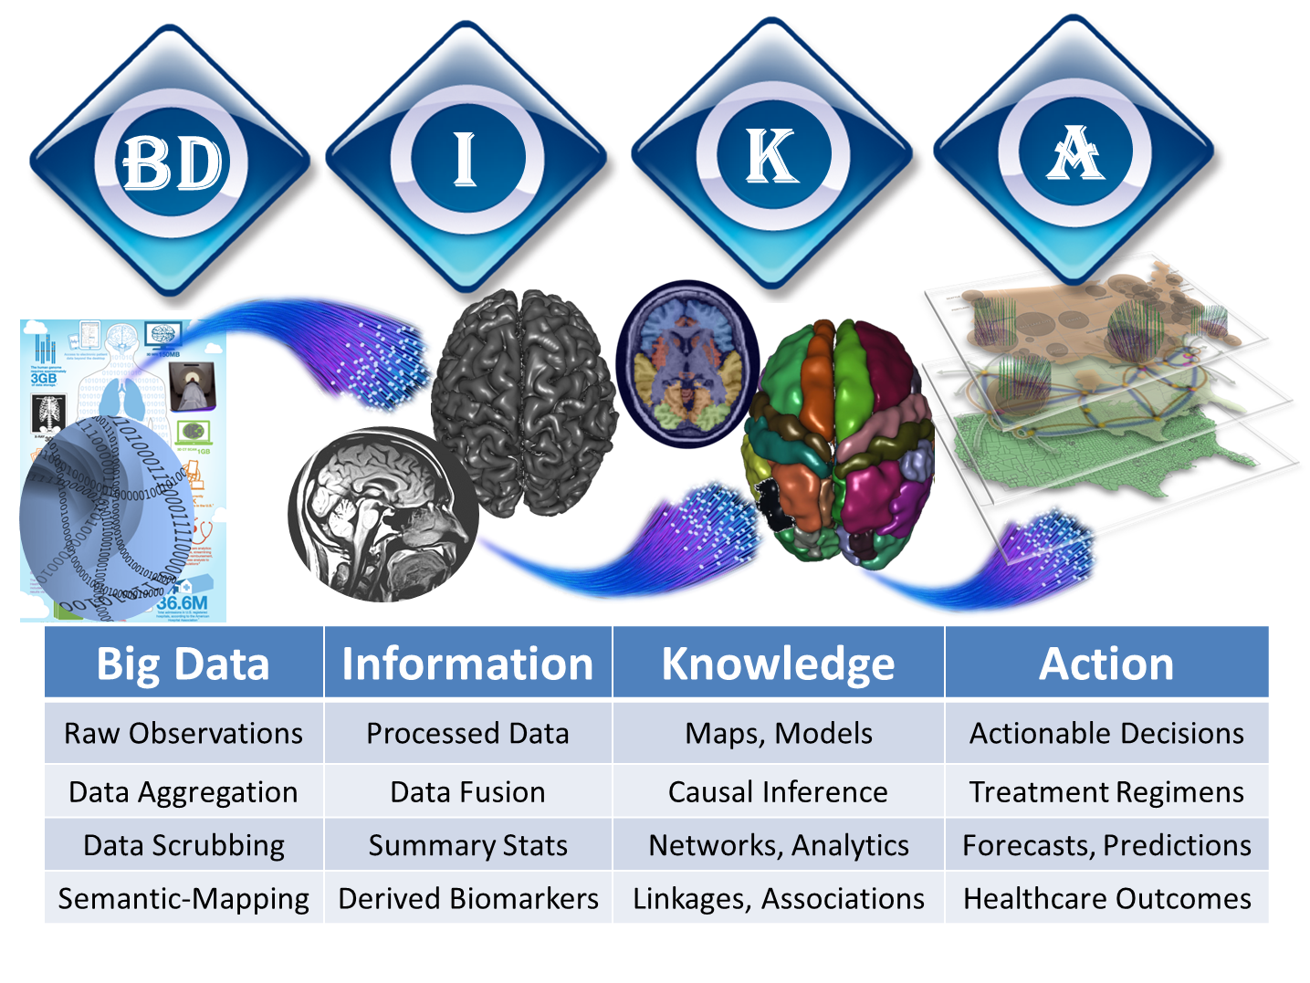
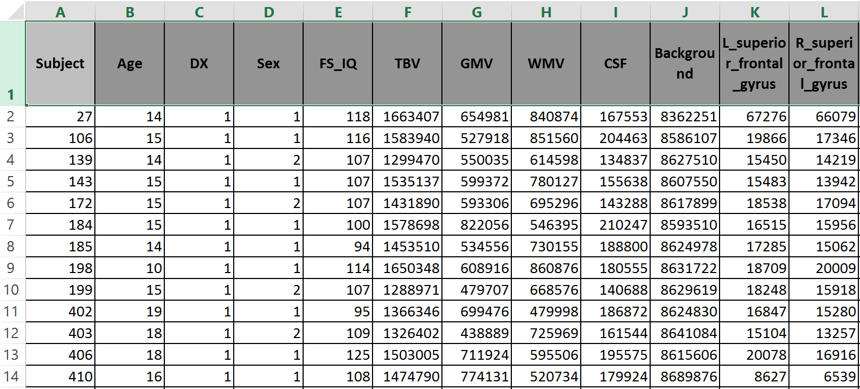

Normal & Schizophrenia
Pediatric Neuroimaging Study

Slide 6
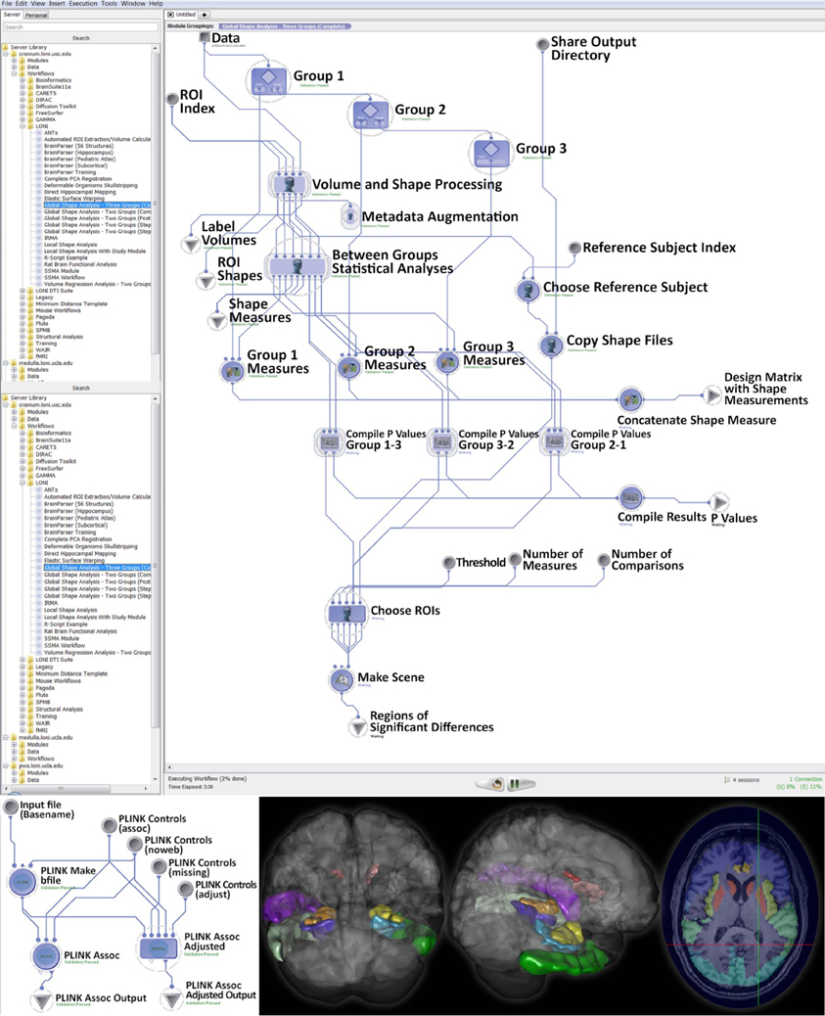
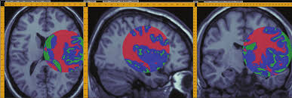
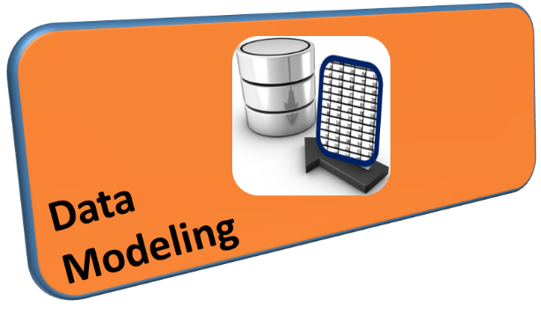

Slide 7
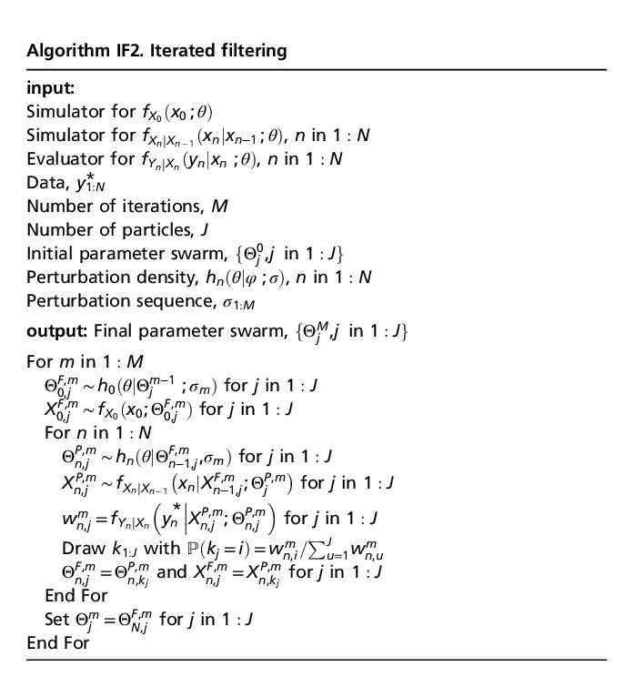
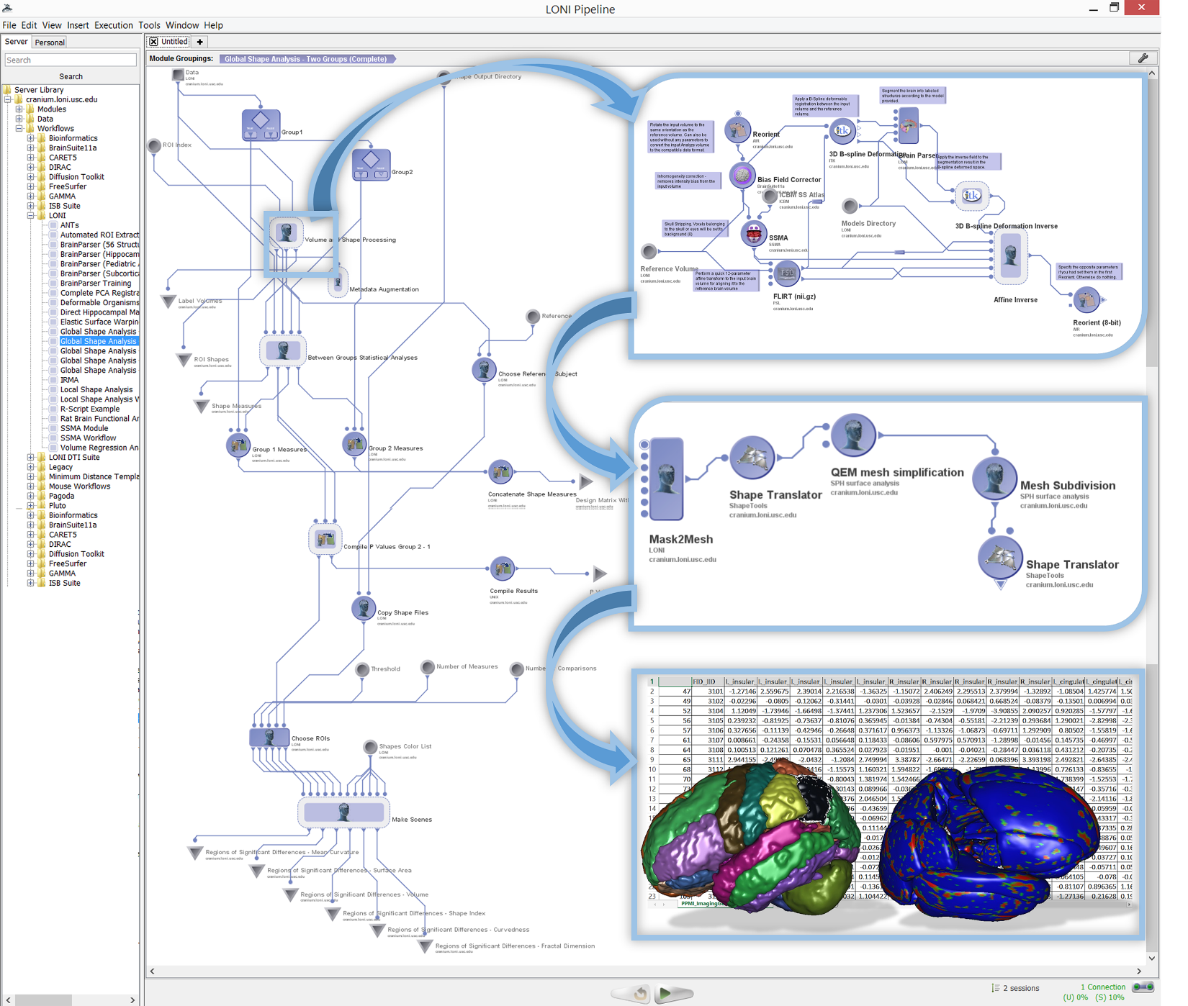
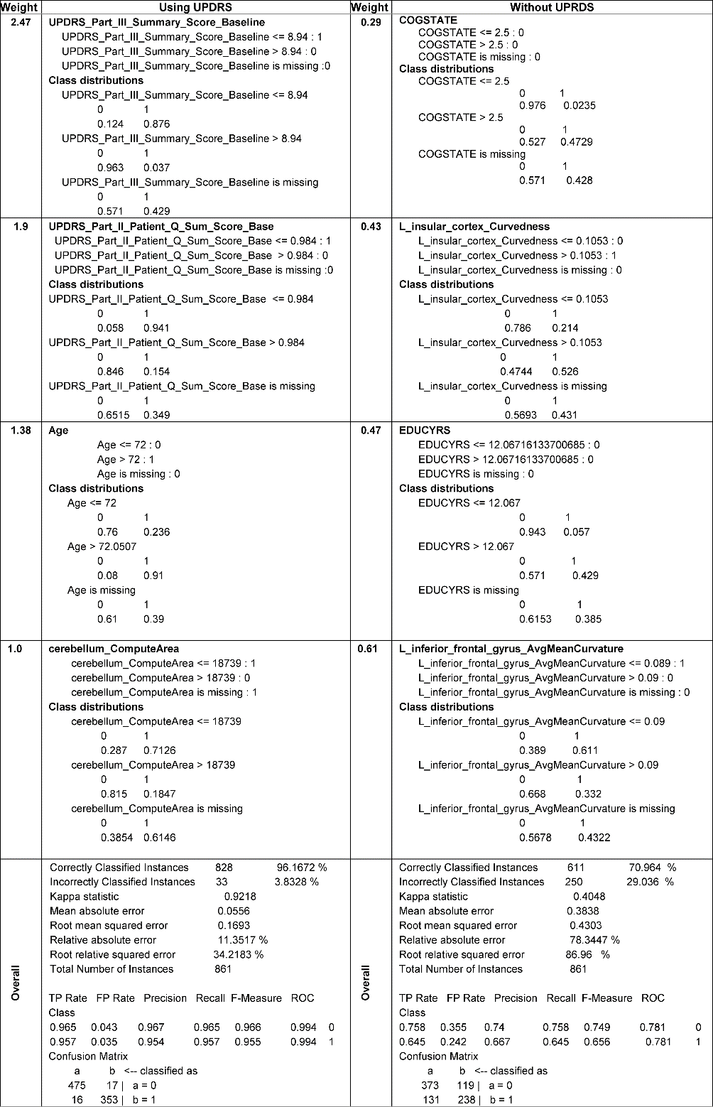
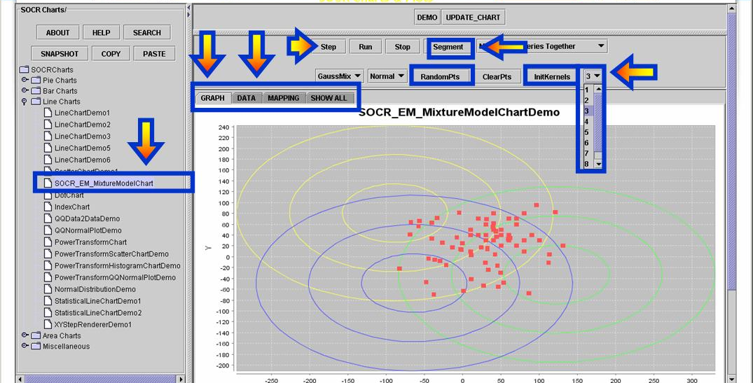
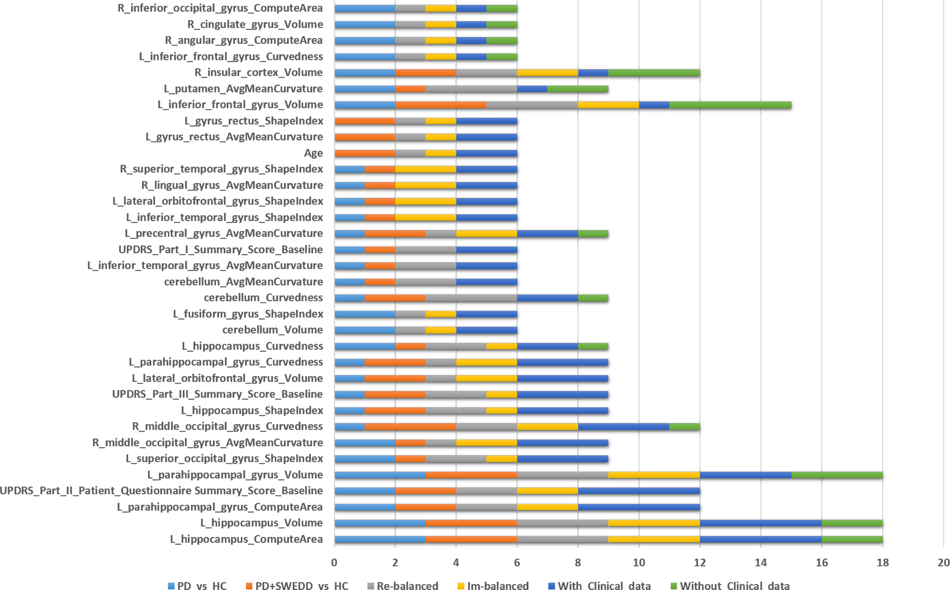
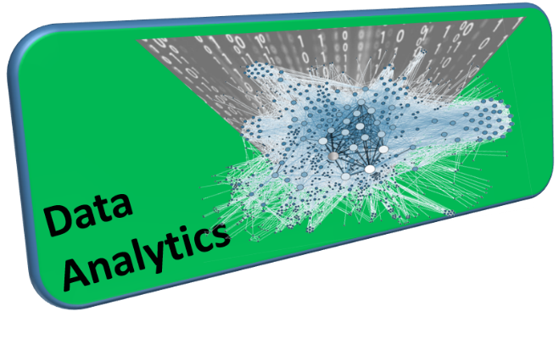
PMID:27494614

Slide 8
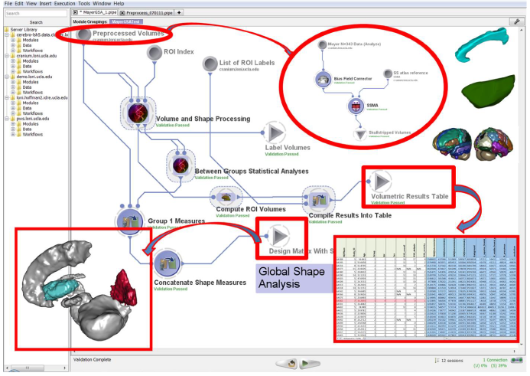
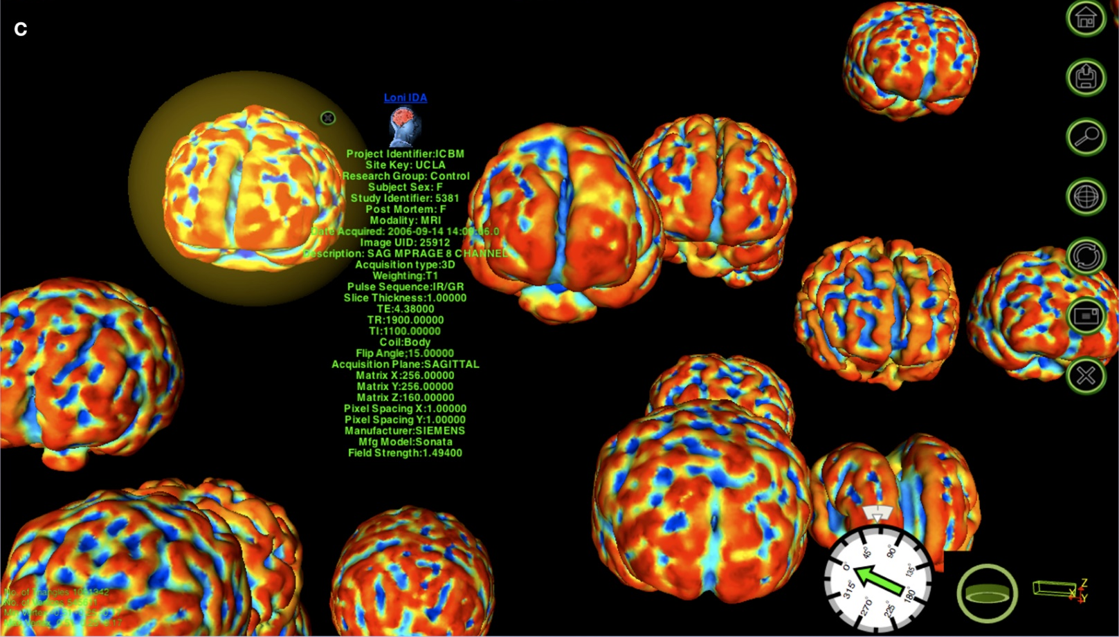
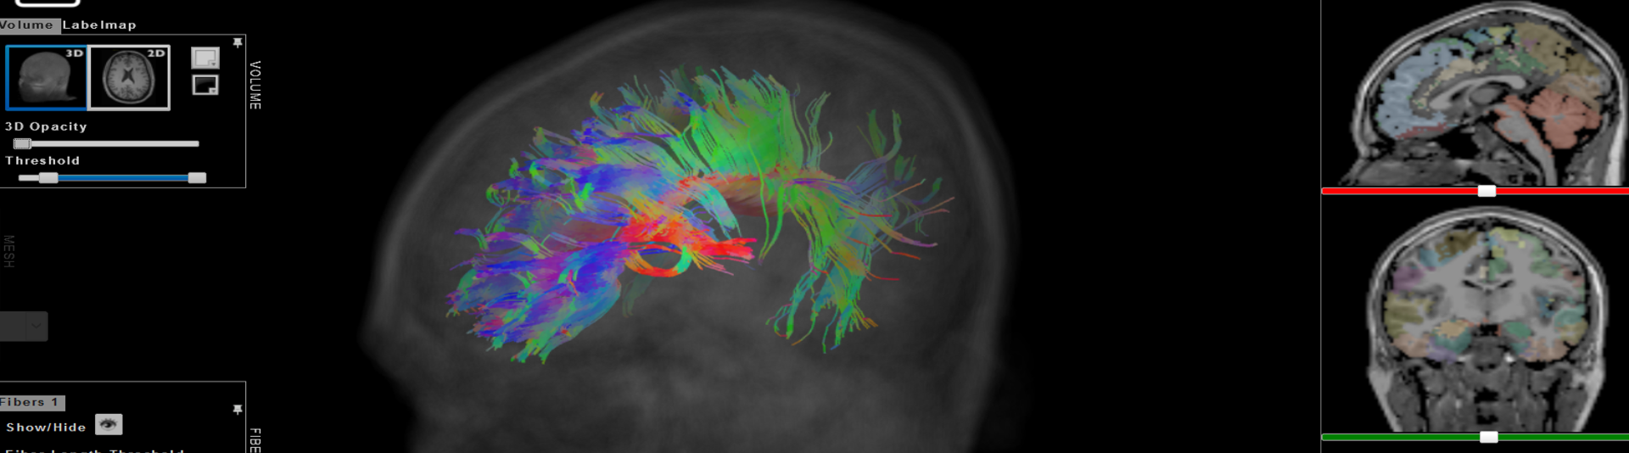
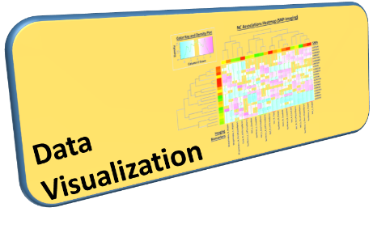

Slide 9
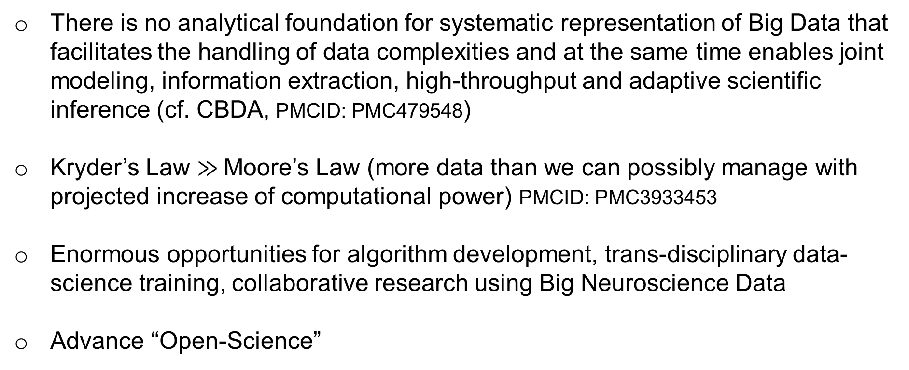
Gaps, Barriers & Opportunities
There is no analytical foundation for systematic representation of Big Data that facilitates the handling of data complexities and at the same time enables joint modeling, information extraction, high-throughput and adaptive scientific inference (cf. CBDA, PMCID: PMC479548)
Kryder’s Law $≫$Moore’s Law (more data than we can possibly manage with projected increase of computational power) PMCID: PMC3933453
Enormous opportunities for algorithm development, trans-disciplinary data-science training, collaborative research using Big Neuroscience Data
Advance “Open-Science”

Slide 10
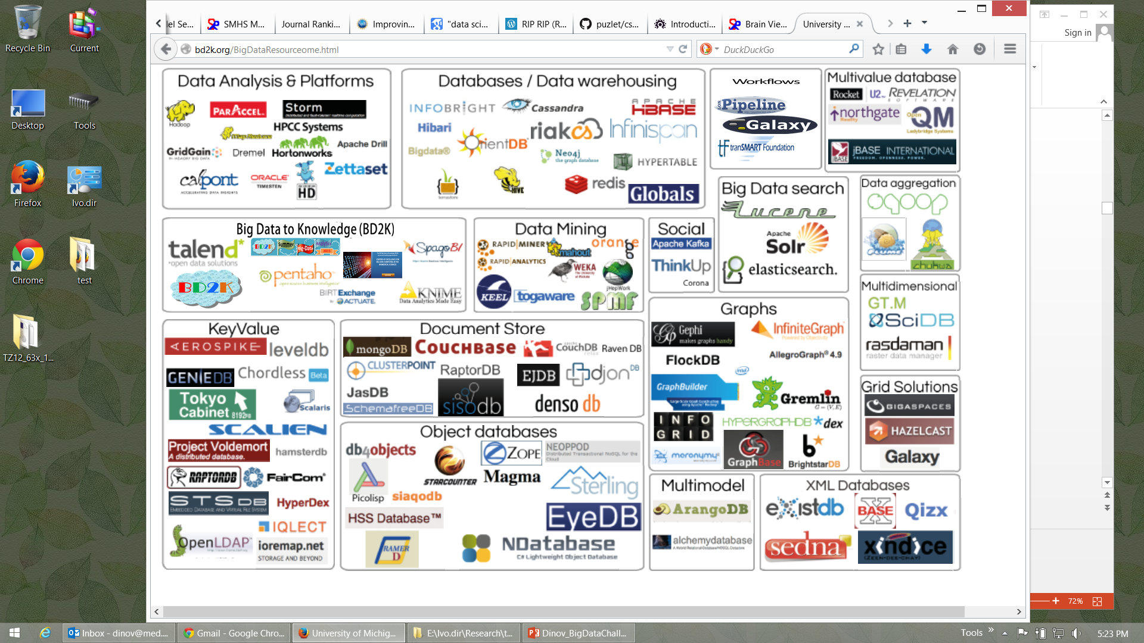




Big Data Analytics Resourceome
http://socr.umich.edu/docs/BD2K/BigDataResourceome.html
Notes:
http://bd2k.org/BigDataResourceome.html

Slide 11
Examples of Available Resources
Source Code: https://github.com/SOCR
End-to-End Pipeline Workflows:
Docs: https://wiki.loni.usc.edu
Protocols: http://pipeline.loni.usc.edu/explore/library-navigator
Pubs: http://www.socr.umich.edu/people/dinov/publications.html
Training/Learning Resources: http://wiki.socr.umich.edu/index.php/SMHS
Data:
Classical: http://wiki.socr.umich.edu/index.php/SOCR_Data
Case-Studies: https://umich.instructure.com/courses/38100/files/folder/Case_Studies

Slide 12
Distributed Services
Processing
Pipeline Try-It-Now Graphical Workflow Environment
(Guest access): http://pipeline.loni.usc.edu/products-services/pws/
socr-pipeline.nursing.umich.edu
AWS/Galaxy: http://GalaxyProject.org
tranSMART: https://github.com/transmart
Data
dbGaP http://dbgap.ncbi.nlm.nih.gov
Neuroimaging http://IDA.loni.usc.edu
XNAT: https://central.xnat.org
Transfer
Globus: http://www.globusonline.org
GridFTP: http://toolkit.globus.org/toolkit/docs/latest-stable/gridftp/

Slide 13
Michigan Institute for Data Science (MIDAS)
MIDAS catalyzes data science at the University of Michigan through support for faculty, research, education and training, and industry engagement
Michigan Institute for Data Science (MIDAS)
Michigan
Data Science
Initiative
Data Science
Services &
Infrastructure
Data Science
Challenge
Initiatives
Consulting for Statistics, Computing & Analytics Research (CSCAR)

Slide 14
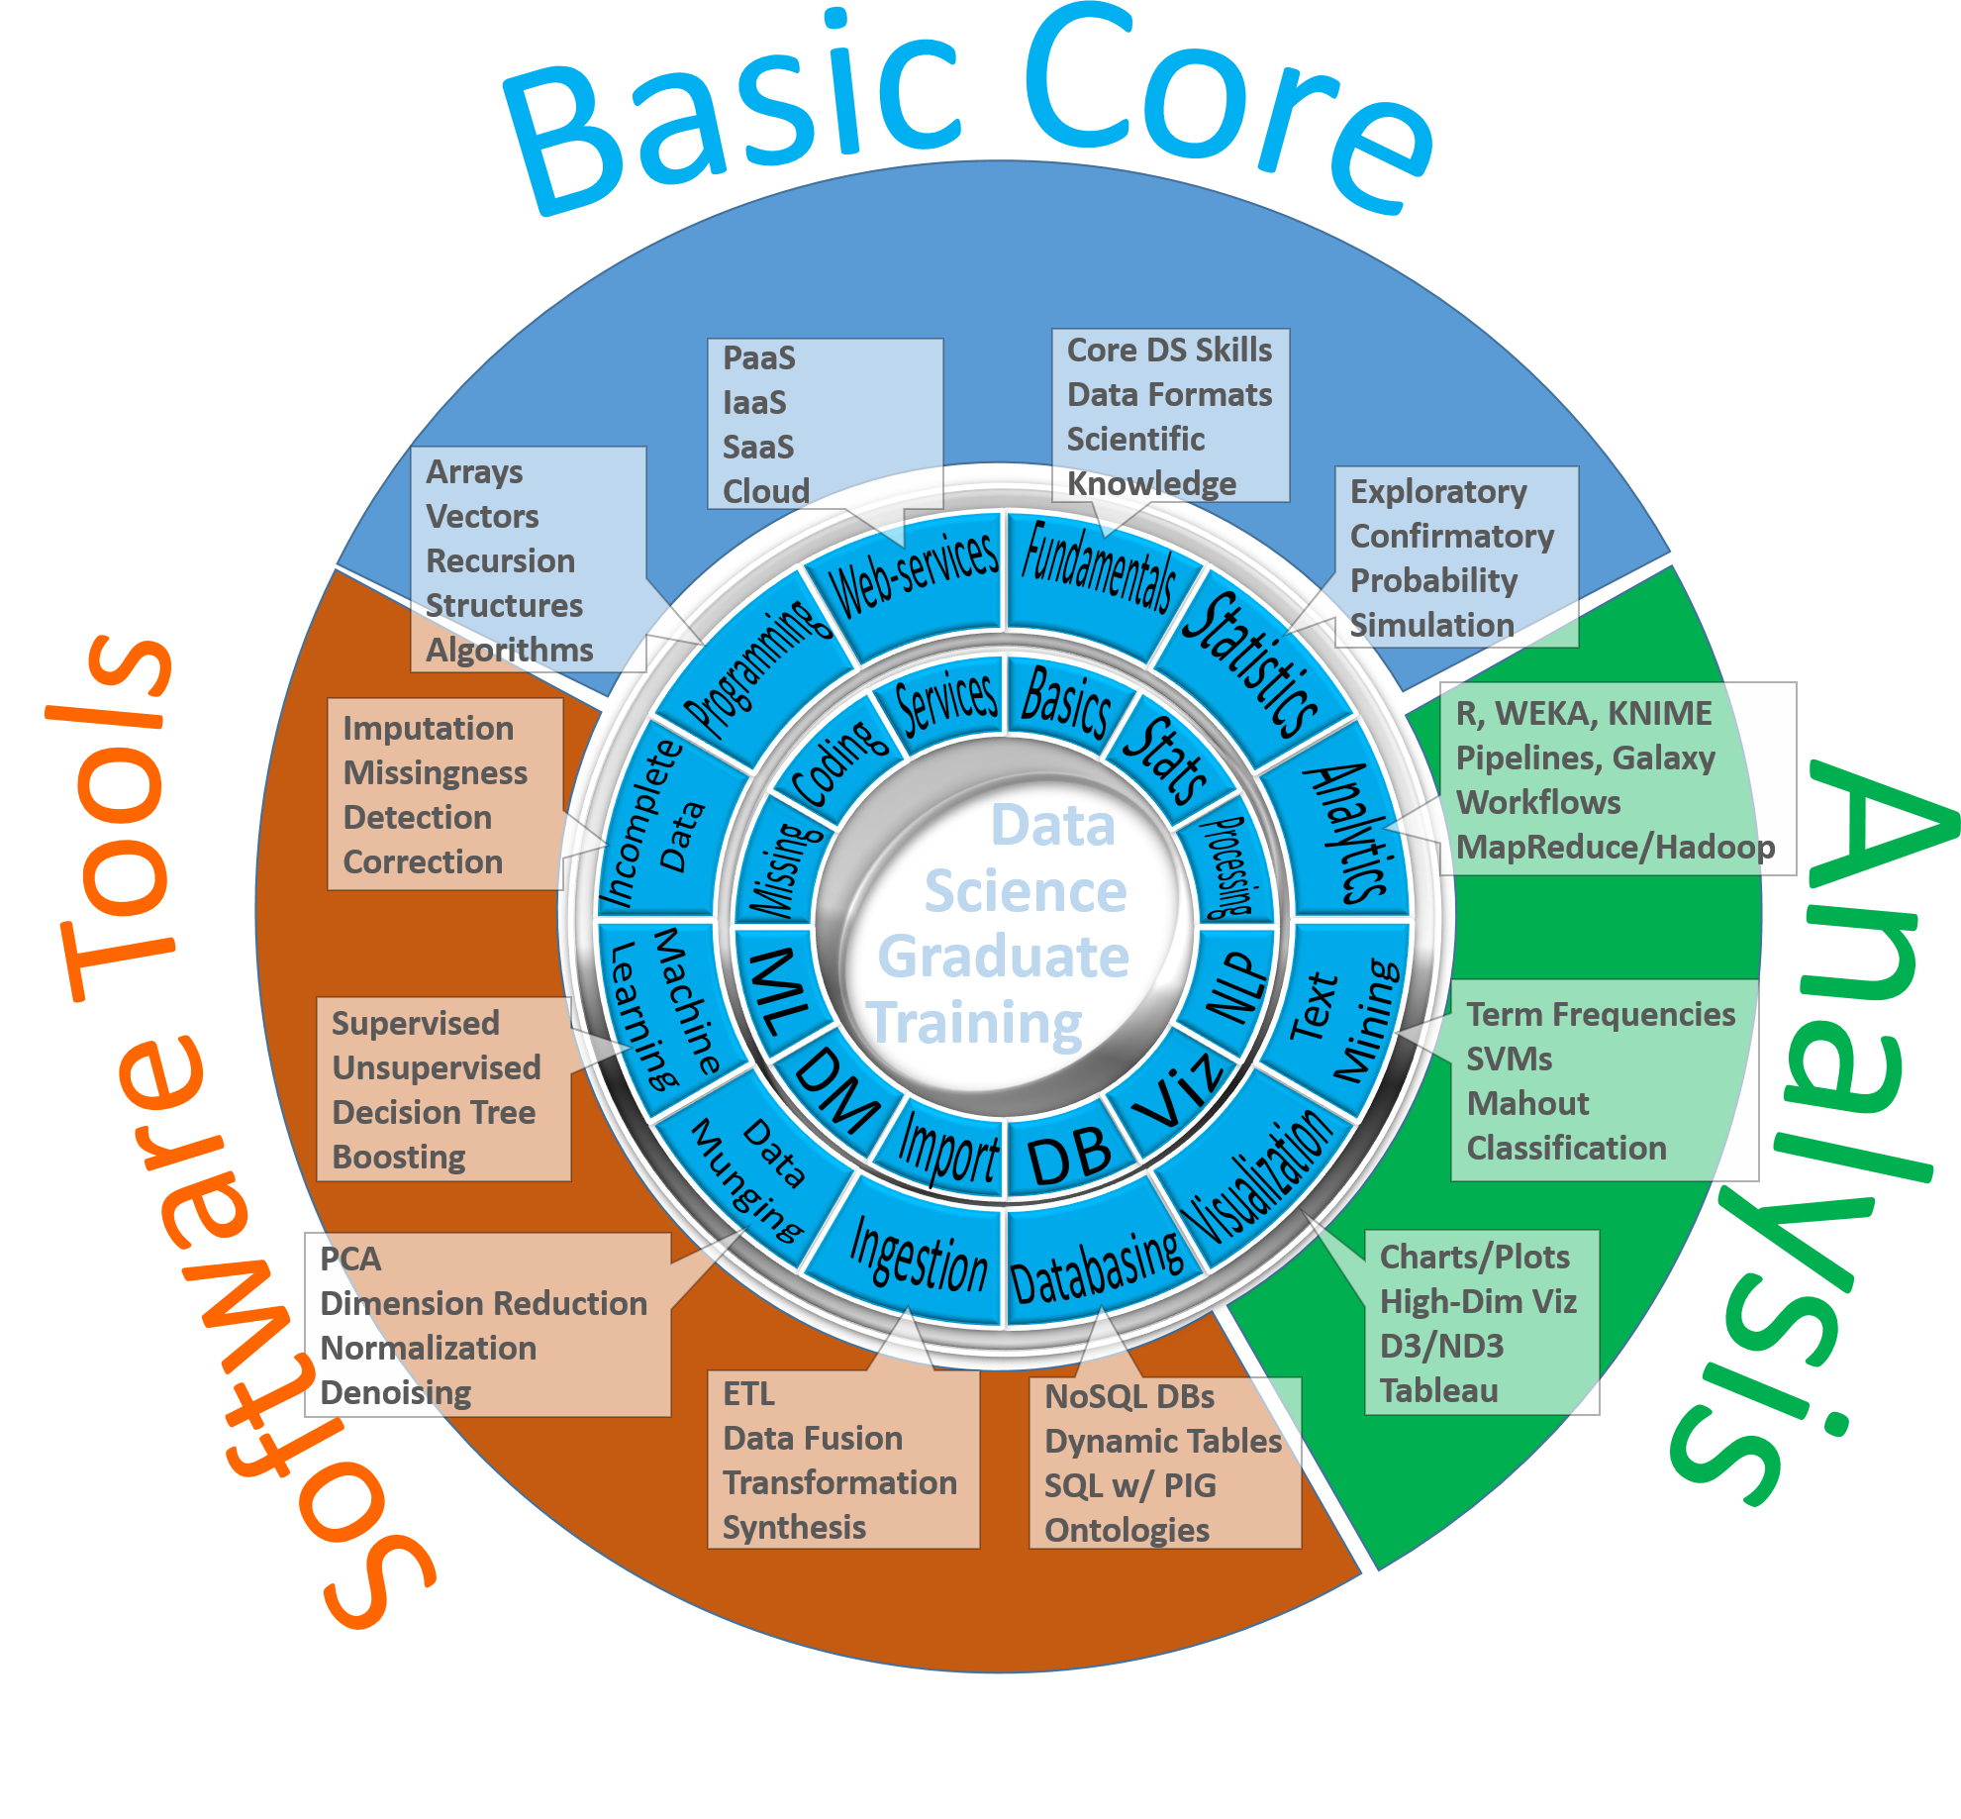
Fundamentals of Data Science Education

Slide 15
Grad DS Curriculum: Prereqs & Competencies
Prerequisites | Skills | Rationale
BS degree or equivalent | Quantitative training and coding skills as described below | The DS certificate is a graduate program requiring a minimum level of quantitative skill
Quantitative training | Undergraduate calculus, linear algebra and intro to probability and statistics | These are the entry level skills required for most upper-level undergrad and grad courses in program
Coding experience | Exposure to software development or programming on the job or in the classroom | Most DS practitioners need substantial experience with Java, C/C++, HTML5, Python, PHP, SQL/DB
Motivation | Significant interest and motivation to pursue quantitative data analytic applications | Dedication for prolonged & sustained immersion into hands-on and methodological research

Slide 16
Grad DS Curriculum: Prereqs & Competencies
Areas | Competency | Expectation | Notes
Algorithms & Applications | Tools | Working knowledge of basic software tools (command-line, GUI based, or web-services) | Familiarity with statistical programming languages, e.g., R or SciKit/Python, and database querying languages, e.g., SQL or NoSQL
 | Algorithms | Knowledge of core principles of scientific computing, applications programming, API’s, algorithm complexity, and data structures | Best practices for scientific and application programming, efficient implementation of matrix linear algebra and graphics, elementary notions of computational complexity, user-friendly interfaces, strings
 | Application Domain | Data analysis experience from at least one application area, either through coursework, internship, research project, etc. | Applied domain examples include: computational social sciences, health sciences, business and marketing, learning sciences, transportation sciences, engineering and physical sciences
Data Management | Data validation & visualization | Curation, Exploratory Data Analysis (EDA) and visualization | Data provenance, validation, visualization via histograms, Q-Q plots, scatterplots (ggplot, Dashboard, D3.js)
 | Data wrangling | Skills for data normalization, data cleaning, data aggregation, and data harmonization/registration | Data imperfections include missing values, inconsistent string formatting (‘2016-01-01’ vs. ‘01/01/2016’, PC/Mac/Lynux time vs. timestamps, structured vs. unstructured data
 | Data infrastructure | Handling databases, web-services, Hadoop, multi-source data | Data structures, SOAP protocols, ontologies, XML, JSON, streaming
Analysis Methods | Statistical inference | Basic understanding of bias and variance, principles of (non)parametric statistical inference, and (linear) modeling | Biological variability vs. technological noise, parametric (likelihood) vs non-parametric (rank order statistics) procedures, point vs. interval estimation, hypothesis testing, regression
 | Study design and diagnostics | Design of experiments, power calculations and sample sizing, strength of evidence, p-values, False Discovery Rates | Multistage testing, variance normalizing transforms, histogram equalization, goodness-of-fit tests, model overfitting, model reduction
 | Machine Learning | Dimensionality reduction, k-nearest neighbors, random forests, AdaBoost, kernelization, SVM, ensemble methods, CNN | Empirical risk minimization. Supervised, semi-supervised, and unsupervised learning. Transfer learning, active learning, reinforcement learning, multiview learning, instance learning

Slide 17
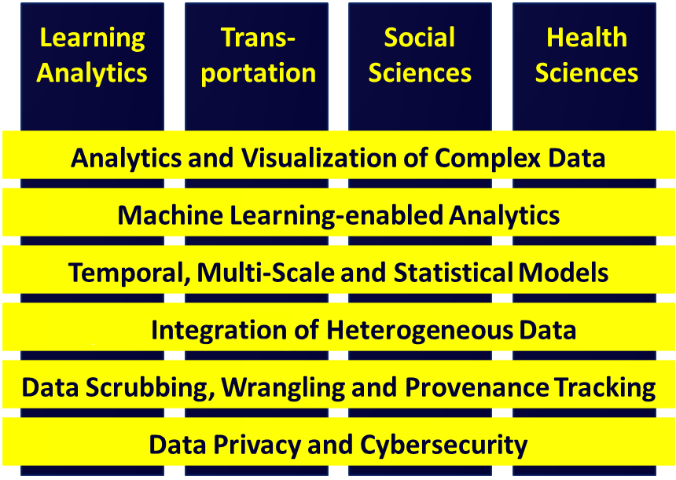
Vertical Integration of MIDAS Challenges and Analytical Methods

